Slide 1
Knowledge Representation

Slide 2
What is Knowledge?
Knowledge is awareness or familiarity gained by experiences of facts, data, and situations.

Slide 3
What is Knowledge Representation?
The main objective of AI system is to design the programs that provide information to the computer, which can be helpful to interact with humans and solve problems in various fields which require human intelligence.

Slide 4
What to Represent:
Following are the kind of knowledge which needs to be represented in AI systems:
Object: All the facts about objects in our world domain. E.g., Guitars contains strings .
Events: Events are the actions which occur in our world.
Performance: It describe behavior which involves knowledge about how to do things.
Meta-knowledge: It is knowledge about what we know.
Facts: Facts are the truths about the real world and what we represent.
Knowledge-Base: The central component of the knowledge-based agents is the knowledge base. It is represented as KB. The Knowledgebase is a group of the Sentences (Here, sentences are used as a technical term and not identical with the English language).

Slide 5
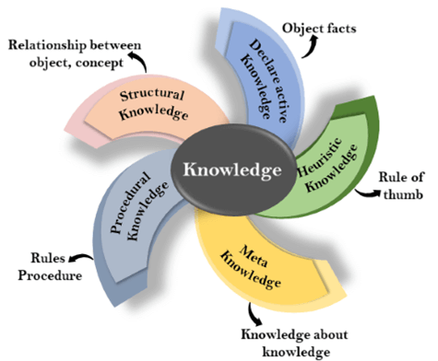
Types of knowledge in AI

Slide 6
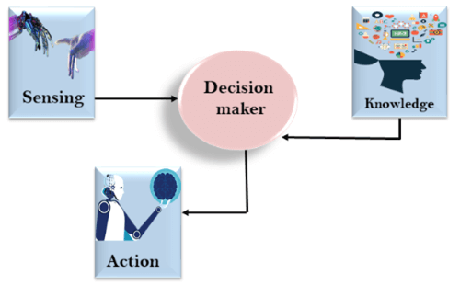
The relation between knowledge and intelligence:

Slide 7
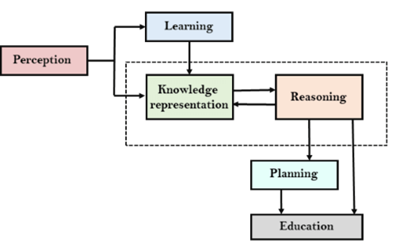
AI knowledge cycle:
An Artificial intelligence system has the following components for displaying intelligent behavior:
Perception
Learning
Knowledge Representation and Reasoning
Planning
Execution

Slide 8
Approaches to knowledge representation:
Simple relational knowledge:
It is the simplest way of storing facts which uses the relational method, and each fact about a set of the object is set out systematically in columns.
This approach of knowledge representation is famous in database systems where the relationship between different entities is represented.
This approach has little opportunity for inference.

Slide 9
2. Inheritable knowledge:
In the inheritable knowledge approach, all data must be stored into a hierarchy of classes.
All classes should be arranged in a generalized form or a hierarchal manner.
In this approach, we apply inheritance property.
Elements inherit values from other members of a class.
This approach contains inheritable knowledge which shows a relation between instance and class, and it is called instance relation.
Every individual frame can represent the collection of attributes and its value.
In this approach, objects and values are represented in Boxed nodes.
We use Arrows which point from objects to their values.

Slide 10
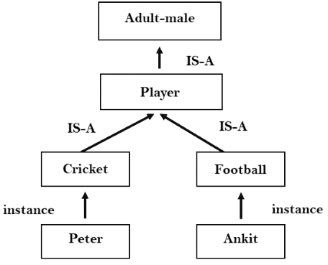

Slide 11
3. Inferential knowledge:
Inferential knowledge approach represents knowledge in the form of formal logics.
This approach can be used to derive more facts.
It guaranteed correctness.

Slide 12
4. Procedural knowledge:
Procedural knowledge approach uses small programs and codes which describes how to do specific things, and how to proceed.
In this approach, one important rule is used which is If-Then rule.
In this knowledge, we can use various coding languages such as LISP language and Prolog language.
We can easily represent heuristic or domain-specific knowledge using this approach.
But it is not necessary that we can represent all cases in this approach.

Slide 13
Requirements for knowledge Representation system:
A good knowledge representation system must possess the following properties.
1. Representational Accuracy: KR system should have the ability to represent all kind of required knowledge.
2. Inferential Adequacy: KR system should have ability to manipulate the representational structures to produce new knowledge corresponding to existing structure.
3. Inferential Efficiency:
The ability to direct the inferential knowledge mechanism into the most productive directions by storing appropriate guides.
4. Acquisitional efficiency- The ability to acquire the new knowledge easily using automatic methods.

